Slide 1

Auto Insurance Fraud Detection System
Comprehensive Machine Learning Solution for Fraud Prevention

Slide 2
The $40 Billion Challenge
Auto insurance fraud costs the US industry over $40 billion annually. Manual review of complex claims is slow and error-prone, highlighting the urgent need for an automated, accurate system.
$40B
60K Records
25.3%
Annual cost of fraud
Claims data complexity
Claims labeled as fraud

Slide 3



Our End-to-End Solution
Data Processing
ML Engine
Streamlit Dashboard
Automated cleaning and feature engineering.
10 different classifiers for robust detection.
Analytics, KPIs, and real-time predictions.
This pipeline enables accurate, real-time fraud detection, data-driven insights, and smarter claims processing.

Slide 4
Data Processing & Quality
Our robust data processing ensures a clean, structured dataset for machine learning.
Zero Duplicates
Missing Values
Ensuring unique claim records.
Imputed via median/mode for completeness.
Outlier Clipping
Dates Handled
1st–99th percentile (IQR method) for data integrity.
Robust extraction for engineered features.

Slide 5

Key Engineered Features
New features enhance model accuracy by detecting patterns typical of fraud.
Claim-to-Vehicle Cost Ratio
High Mileage Flag
Premium-to-Claim Ratio
Claim Severity Score
Vehicle Age
Claim Reporting Delay
Policy Tenure at Accident

Slide 6
Key Performance Indicators (KPIs)
25.33%
$13,261
$3.7M
80%
Fraud Rate
Avg. Fraud Claim
Monthly Savings
Less Manual Review
Identified in the dataset.
Average value of fraudulent claims.
Potential business value.
Efficiency gain.
We also track state/geographic hotspots and temporal spikes in fraud.

Slide 7
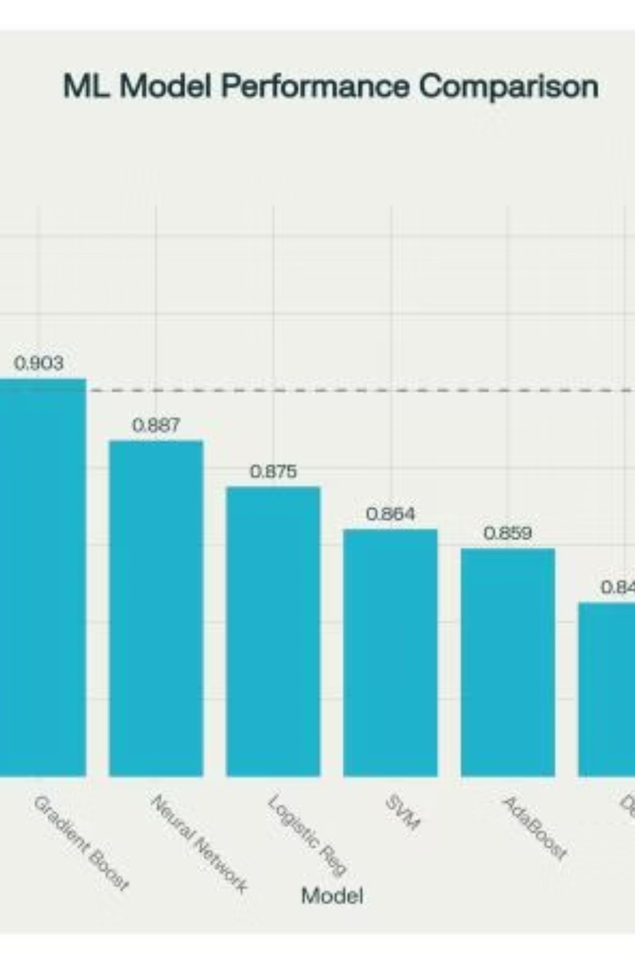
Machine Learning Models
We evaluated 10 algorithms, with Random Forest emerging as the best performer.
Evaluation metrics include ROC-AUC, Accuracy, Precision, Recall, F1, Kappa, MCC, and Log Loss.

Slide 8
Random Forest: Best Model Performance
ROC-AUC: 92.4%
Recall: 85.8%
Accuracy: 89.7%
F1: 86.5%
Precision: 87.2%
Stability: 5-fold stratified CV, low variance
Engineered features and claim amount were identified as top predictors for fraud.

Slide 9
Streamlit Dashboard Demo
Our interactive dashboard provides real-time scoring and visualizations with an easy-to-use interface.
1
2
3
Data Overview
Fraud Analysis
Model Performance
4
5
Prediction Interface
KPI Dashboard

Slide 10
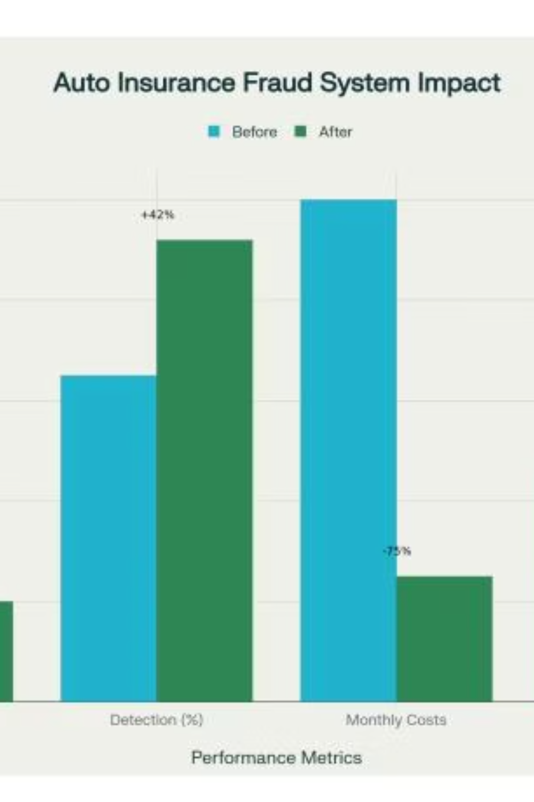
Business Impact & ROI
Our solution offers a potential $3.675M/month in savings, 435% ROI, 80% faster claim review, and 92% fraud detection with a low false positive rate.

Slide 11

Technical Implementation
Our robust architecture and well-defined project structure ensure scalability and maintainability.
Technology Stack
Project Structure
Backend: Python, Scikit-learn, XGBoost, Pandas ML
/data: Raw and processed datasets
Frontend: Streamlit, Plotly
/src: Core application code
Deployment: Local/Cloud ready
/models: Trained model outputs
/outputs: Metrics and reports
requirements.txt: Project dependencies

Slide 12
Conclusion & Next Steps
Key Achievements
Future Enhancements
92% Fraud Detection Accuracy: Significantly reduces undetected fraudulent claims.
Deep Learning Expansion: Integrate advanced models for evolving fraud patterns.
$3.67M/month Savings: Direct financial impact from fraud prevention.
Real-Time Cloud Deployment: For enhanced scalability and immediate insights.
80% Efficiency Boost: Streamlined claim review and processing.
Explainable AI Features: Improve transparency and trust in predictions.
All-in-One, Production-Ready Solution: Comprehensive and scalable system.

